Slide 1
Algorithms
Recurrences

Slide 2
Recurrences
MERGE-SORT
  T(n) = Θ(1) if n=1
2T(n/2)+ Θ(n) if n>1
  Ignore certain details:
    T(n) = Θ(1) if n=1
T(⎡n/2⎤)+ T(⎣n/2⎦)+ Θ(n) if n>1
    Moreover, T(n) = 2T(n/2)+ Θ(n)

Slide 3
The Substitution Method
Two steps:
  Guess the form of the solution.
    By experience, and creativity.
    By Some heuristics.
      If a recurrence is similar to one you have seen before.
        T(n)=2T(⎣n/2⎦+17)+n, similar to T(n)=2T(⎣n/2⎦)+n, , guess O(nlg n).
      Prove loose upper and lower bounds on the recurrence and then reduce the range of uncertainty.
        For T(n)=2T(⎣n/2⎦)+n, prove lower bound T(n)= Ω(n), and prove upper bound T(n)= O(n²), then guess the tight bound is T(n)=O(nlg n).
    By recursion tree.
  Use mathematical induction to find the constants and show that the solution works.

Slide 4
Solve T(n)=2T(⎣n/2⎦)+n
Guess the solution: T(n)=O(nlg n),
  i.e., T(n)≤ cnlg n for some c.
Prove the solution by induction:
  Suppose this bound holds for ⎣n/2⎦, i.e.,
    T(⎣n/2⎦)≤ c⎣n/2⎦ lg (⎣n/2⎦).
  T(n) ≤ 2(c⎣n/2⎦ lg (⎣n/2⎦))+n
    ≤ cn lg (n/2))+n
    = cn lg n - cn lg 2 +n
    = cn lg n - cn +n
    ≤ cn lg n (as long as c≥1)
Is the above proof complete? Why?

Slide 5
Boundary (base) Condition
In fact, T(n) =1 if n=1, i.e., T(1)=1.
However, cnlg n =c×1×lg 1 = 0, which is odd with T(1)=1.
Take advantage of asymptotic notation: it is required T(n)≤ cnlg n hold for n≥ n₀ where n₀ is a constant of our choosing.
Select n₀ =2, thus, n=2 and n=3 as our induction bases. It turns out any c ≥ 2 suffices for base cases of n=2 and n=3 to hold.

Slide 6
Subtleties
Guess is correct, but induction proof not work.
Problem is that inductive assumption not strong enough.
Solution: revise the guess by subtracting a lower-order term.
Example: T(n)=T(⎣n/2⎦)+T(⎡n/2⎤)+1.
  Guess T(n)=O(n), i.e., T(n) ≤ cn for some c.
  However, T(n) ≤c ⎣n/2⎦+c ⎡n/2⎤+1 =cn+1, which does not imply T(n) ≤ cn for any c.
  Attempting T(n)=O(n²) will work, but overkill.
  New guess T(n) ≤ cn – b will work as long as b ≥ 1.

Slide 7
Avoiding Pitfall
It is easy to guess T(n)=O(n) (i.e., T(n) ≤ cn) for T(n)=2T(⎣n/2⎦)+n.
And wrongly prove:
  T(n) ≤ 2(c ⎣n/2⎦)+n
    ≤ cn+n
    =O(n). ⬅ wrongly !!!!
Problem is that it does not prove the exact form of T(n) ≤ cn.

Slide 8
Changing Variables
Suppose T(n)=2T(√n)+lg n.
Rename m=lg n. so T(2^{m})=2T(2^{m/2})+m.
Rename S(m)=T(2^{m}), so S(m)=2S(m/2)+m.
Which is similar to T(n)=2T(⎣n/2⎦)+n.
So the solution is S(m)=O(m lg m).
Changing back to T(n) from S(m), the solution is T(n) =T(2^{m})=S(m)=O(m lg m)=O(lg n lg lg n).

Slide 9
The Recursion-tree Method
Idea:
  Each node represents the cost of a single subproblem.
  Sum up the costs with each level to get level cost.
  Sum up all the level costs to get total cost.
Particularly suitable for divide-and-conquer recurrence.
Best used to generate a good guess, tolerating “sloppiness”.
If trying to compute cost as exact as possible, then used as direct proof.

Slide 10
Recursion Tree for T(n)=3T(⎣n/4⎦)+Θ(n²)
T(n)
cn²
cn²
T(n/4)
T(n/4)
T(n/4)
c(n/4)²
c(n/4)²
c(n/4)²
T(n/16)
T(n/16)
T(n/16)
T(n/16)
T(n/16)
T(n/16)
T(n/16)
T(n/16)
T(n/16)
(a)
(b)
(c)
cn²
cn²
c(n/4)²
c(n/4)²
(3/16)cn²
c(n/4)²
log ₄^{n}
(3/16)²cn²
c(n/16)²
c(n/16)²
c(n/16)²
c(n/16)²
c(n/16)²
c(n/16)²
c(n/16)²
c(n/16)²
c(n/16)²
T(1)
T(1)
T(1)
T(1)
T(1)
T(1)
Θ(n^{log} 4³)
n^{log} 4³
Total O(n²)
(d)

Slide 11
Solution to T(n)=3T(⎣n/4⎦)+Θ(n²)
The height is log ₄^{n},
#leaf nodes = 3^{log 4n}= n^{log 43}. Leaf node cost: T(1).
Total cost T(n)=cn²+(3/16) cn²+(3/16)² cn²+
…+(3/16)^{log} 4^{n-1} cn²+ Θ(n^{log} 4³)
=(1+3/16+(3/16)²+…+(3/16)^{log} 4^{n-1}) cn² + Θ(n^{log} 4³)
<(1+3/16+(3/16)²+…+(3/16)^{m}+…⁾ cn² + Θ(n^{log} 4³)
=(1/(1-3/16)) cn² + Θ(n^{log} 4³)
=16/13cn² + Θ(n^{log} 4³)
=O(n²).

Slide 12
Prove the above Guess
T(n)=3T(⎣n/4⎦)+Θ(n²) =O(n²).
Show T(n) ≤dn² for some d.
T(n) ≤3(d (⎣n/4⎦)²) +cn²
≤3(d (n/4)²) +cn²
=3/16(dn²) +cn²
≤ dn², as long as d≥(16/13)c.

Slide 13
One more example
T(n)=T(n/3)+ T(2n/3)+O(n).
Construct its recursive tree (Figure 4.2, page 71).
T(n)=O(cnlg_{3/2}^{n}) = O(nlg n).
Prove T(n) ≤ dnlg n.

Slide 14
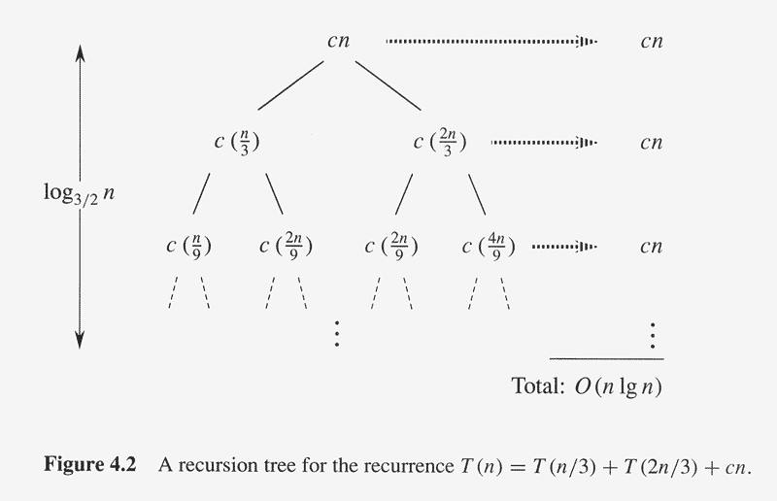
Recursion Tree of T(n)=T(n/3)+ T(2n/3)+O(n)

Slide 15
Master Method/Theorem
Theorem 4.1 (page 73)
  for T(n) = aT(n/b)+f(n), n/b may be ⎡n/b⎤ or ⎣n/b⎦.
  where a ≥ 1, b>1, f(n) be a function.
  If f(n)=O(n^{log}b^{a-ε}) for some ε>0, then T(n)= Θ(n^{log}bª).
  If f(n)= Θ(n^{log}bª), then T(n)= Θ(n^{log}bª lg n).
  If f(n)=Ω(n^{log}b^{a+ε}) for some ε>0, and if af(n/b) ≤cf(n) for some c<1 and all sufficiently large n, then T(n)= Θ(f(n)).

Slide 16
Implications of Master Theorem
Comparison between f(n) and n^{log}bª (<,=,>)
Must be asymptotically smaller (or larger) by a polynomial, i.e., n^{ε} for some ε>0.
In case 3, the “regularity” must be satisfied, i.e., af(n/b) ≤cf(n) for some c<1 .
There are gaps
  between 1 and 2: f(n) is smaller than n^{log}bª, but not polynomially smaller.
  between 2 and 3: f(n) is larger than n^{log}bª, but not polynomially larger.
  in case 3, if the “regularity” fails to hold.

Slide 17
Application of Master Theorem
T(n) = 9T(n/3)+n;
  a=9,b=3, f(n) =n
  n^{log}bª = n^{log}3⁹ = Θ (n²)
  f(n)=O(n^{log}3^{9-ε}) for ε=1
  By case 1, T(n) =Θ (n²).
T(n) = T(2n/3)+1
  a=1,b=3/2, f(n) =1
  n^{log}bª = n^{log}3/2¹ = Θ (n⁰) = Θ (1)
  By case 2, T(n)= Θ(lg n).

Slide 18
Application of Master Theorem
T(n) = 3T(n/4)+nlg n;
  a=3,b=4, f(n) =nlg n
  n^{log}bª = n^{log}4³ = Θ (n^{0.793})
  f(n)= Ω(n^{log}4^{3+ε}) for ε≈0.2
  Moreover, for large n, the “regularity” holds for c=3/4.
    af(n/b) =3(n/4)lg (n/4) ≤ (3/4)nlg n = cf(n)
  By case 3, T(n) =Θ (f(n))=Θ (nlg n).

Slide 19
Exception to Master Theorem
T(n) = 2T(n/2)+nlg n;
  a=2,b=2, f(n) =nlg n
  n^{log}bª = n^{log}2² = Θ (n)
  f(n) is asymptotically larger than n^{log}bª , but not polynomially larger because
  f(n)/n^{log}bª = lg n, which is asymptotically less than n^{ε} for any ε>0.
  Therefore,this is a gap between 2 and 3.

Slide 20
Where Are the Gaps
f(n), case 3, at least polynomially larger
n^{ε}
Gap between case 3 and 2
c₁
n^{logba}
f(n), case 2: within constant distances
c₂
n^{ε}
Gap between case 1 and 2
f(n), case 1, at least polynomially smaller
Note: 1. for case 3, the regularity also must hold.
2. if f(n) is lg n smaller, then fall in gap in 1 and 2
3. if f(n) is lg n larger, then fall in gap in 3 and 2
4. if f(n)=Θ(n^{logba}lg^{k}n), then T(n)=Θ(n^{logba}lg^{k+1}n). (as exercise)

Slide 21
Proof of Master Theorem
The proof for the exact powers, n=b^{k} for k≥1.
Lemma 4.2
  for T(n) = Θ(1) if n=1
  aT(n/b)+f(n) if n=b^{k} for k≥1
  where a ≥ 1, b>1, f(n) be a nonnegative function,
  Then
  T(n) = Θ(n^{logba})+ a^{j}f(n/b^{j})
Proof:
  By iterating the recurrence
  By recursion tree (See figure 4.3)
log_{b}^{n-1}
∑
j=0

Slide 22
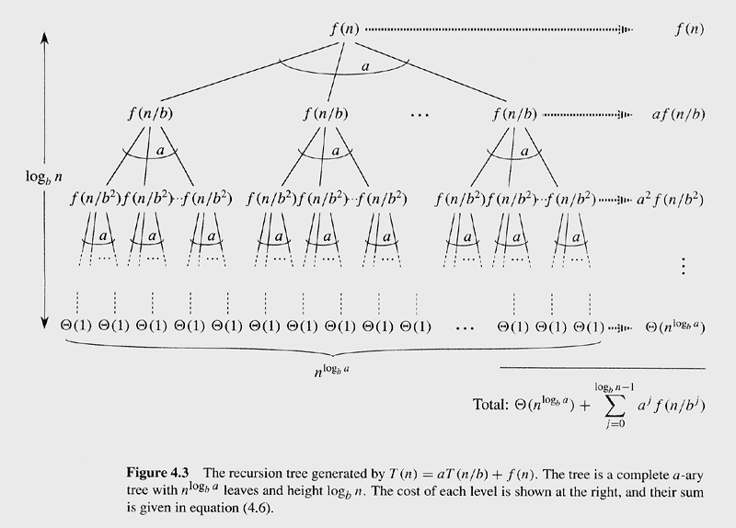
Recursion tree for T(n)=aT(n/b)+f(n)

Slide 23
Proof of Master Theorem (cont.)
Lemma 4.3:
  Let a ≥ 1, b>1, f(n) be a nonnegative function defined on exact power of b, then
  g(n)= a^{j}f(n/b^{j}) can be bounded for exact power of b as:
  If f(n)=O(n^{log}b^{a-ε}) for some ε>0, then g(n)= O(n^{log}bª).
  If f(n)= Θ(n^{log}bª), then g(n)= Θ(n^{log}bª lg n).
  If af(n/b) ≤cf(n) for some c<1 and all sufficiently large n ≥b, then g(n)= Θ(f(n)).
log_{b}^{n-1}
∑
j=0

Slide 24
Proof of Lemma 4.3
For case 1: f(n)=O(n^{log}b^{a-ε}) implies f(n/b^{j})=O((n /b^{j})^{log}b^{a-ε}), so
g(n)= a^{j}f(n/b^{j}) =O( a^{j}(n /b^{j})^{log}b^{a-ε} )
= O(n^{log}b^{a-ε} a^{j}/(b^{log}b^{a-ε})^{j} ) = O(n^{log}b^{a-ε} a^{j}/(a^{j}(b^{-ε})^{j}))
= O(n^{log}b^{a-ε} (b^{ε})^{j} ) = O(n^{log}b^{a-ε} (((b^{ε} ) ^{logbn}-1)/(b^{ε}-1) )
= O(n^{log}b^{a-ε} (((b^{logbn})^{ε} -1)/(b^{ε}-1)))=O(n^{log}bª n^{-ε} (n^{ε} -1)/(b^{ε}-1))
= O(n^{log}bª )
log_{b}^{n-1}
log_{b}^{n-1}
∑
∑
j=0
j=0
log_{b}^{n-1}
log_{b}^{n-1}
∑
∑
j=0
j=0
log_{b}^{n-1}
∑
j=0

Slide 25
Proof of Lemma 4.3(cont.)
For case 2: f(n)= Θ(n^{log}bª) implies f(n/b^{j})= Θ((n /b^{j})^{log}bª), so
g(n)= a^{j}f(n/b^{j}) = Θ( a^{j}(n /b^{j})^{log}bª)
= Θ(n^{log}bª a^{j}/(b^{log}bª)^{j} ) = Θ(n^{log}bª 1)
= Θ(n^{log}bª log_{b}^{n}) = Θ(n^{log}bªlg n)
log_{b}^{n-1}
log_{b}^{n-1}
∑
∑
j=0
j=0
log_{b}^{n-1}
log_{b}^{n-1}
∑
∑
j=0
j=0

Slide 26
Proof of Lemma 4.3(cont.)
For case 3:
  Since g(n) contains f(n), g(n) = Ω(f(n))
  Since af(n/b) ≤cf(n), a^{j}f(n/b^{j}) ≤c^{j}f(n) , why???
  g(n)= a^{j}f(n/b^{j}) ≤ c^{j}f(n) ≤ f(n) c^{j}
  =f(n)(1/(1-c)) =O(f(n))
  Thus, g(n)=Θ(f(n))
log_{b}^{n-1}
log_{b}^{n-1}
∞
∑
∑
∑
j=0
j=0
j=0

Slide 27
Proof of Master Theorem (cont.)
Lemma 4.4:
  for T(n) = Θ(1) if n=1
  aT(n/b)+f(n) if n=b^{k} for k≥1
  where a ≥ 1, b>1, f(n) be a nonnegative function,
  If f(n)=O(n^{log}b^{a-ε}) for some ε>0, then T(n)= Θ(n^{log}bª).
  If f(n)= Θ(n^{log}bª), then T(n)= Θ(n^{log}bª lg n).
  If f(n)=Ω(n^{log}b^{a+ε}) for some ε>0, and if af(n/b) ≤cf(n) for some c<1 and all sufficiently large n, then T(n)= Θ(f(n)).

Slide 28
Proof of Lemma 4.4 (cont.)
Combine Lemma 4.2 and 4.3,
  For case 1:
    T(n)= Θ(n^{log}bª)+O(n^{log}bª)=Θ(n^{log}bª).
  For case 2:
    T(n)= Θ(n^{log}bª)+Θ(n^{log}bª lg n)=Θ(n^{log}bª lg n).
  For case 3:
    T(n)= Θ(n^{log}bª)+Θ(f(n))=Θ(f(n)) because f(n)= Ω(n^{log}b^{a+ε}).

Slide 29
Floors and Ceilings
T(n)=aT(⎣n/b⎦)+f(n) and T(n)=aT(⎡n/b⎤)+f(n)
Want to prove both equal T(n)=aT(n/b)+f(n)
Two results:
  Master theorem applied to all integers n.
  Floors and ceilings does not change the result.
Since ⎣n/b⎦≤n/b, and ⎡n/b⎤≥ n/b, upper bound for floors and lower bound for ceiling is held.
So prove upper bound for ceilings (similar for lower bound for floors).

Slide 30
Upper bound of proof for T(n)=aT(⎡n/b⎤)+f(n)
consider sequence n, ⎡n/b⎤, ⎡ ⎡n/b⎤/b⎤, ⎡ ⎡ ⎡n/b⎤ /b⎤/b⎤, …
Let us define n_{j} as follows:
n_{j} = n if j=0
= ⎡n_{j-1}/b⎤ if j>0
The sequence will be n₀, n₁, …, n_{⎣logbn⎦}
Draw recursion tree:

Slide 31
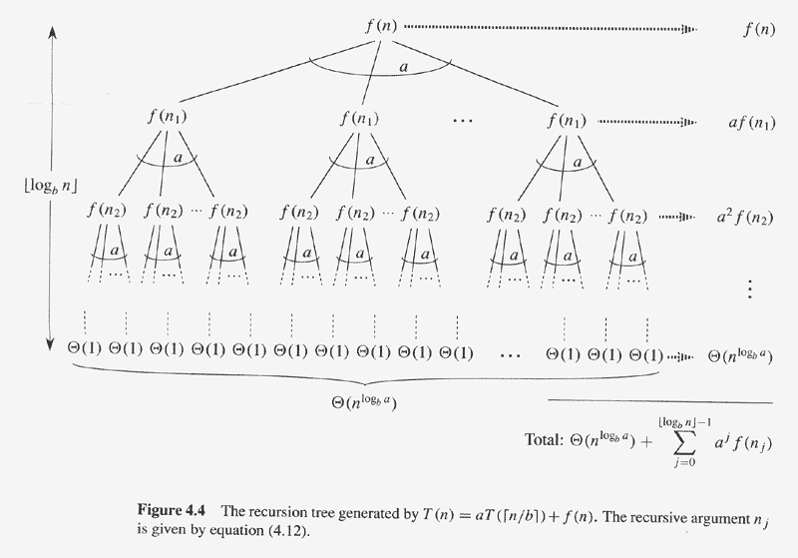
Recursion tree of T(n)=aT(⎡n/b⎤)+f(n)

Slide 32
The proof of upper bound for ceiling
⎣log_{b}^{n}⎦ ⁻¹
∑
  T(n) = Θ(n^{logba})+ a^{j}f(n_{j})
  Thus similar to Lemma 4.3 and 4.4, the upper bound is proven.
j=0

Slide 33
Summary
Analysis of running time and space
  Worst case running time.
  Average case (expected) running time.
    Amortized analysis and amortized cost.
  Best cast running time.
Loop invariant and its proof.
Asymptotic notations, definitions and relations.
Recurrences and their bounds
  Substitution
  Recursion tree
  Master theorem.
  Proof of subtleties and recurrence Master theorem does not apply to.

